Slide 1
Generating GCODE from unrouted PCB
By: Franco Harding

Slide 2
Requirements
KiCAD 6.0+
Components and symbols from correctly installed from the 4DPrinting folder. (if PCB uses custom components)
Cloned Github Repository https://github.com/ffharding/4DPrinting-KiCAD.
Valid netlist compatible with EEschema.

Slide 3
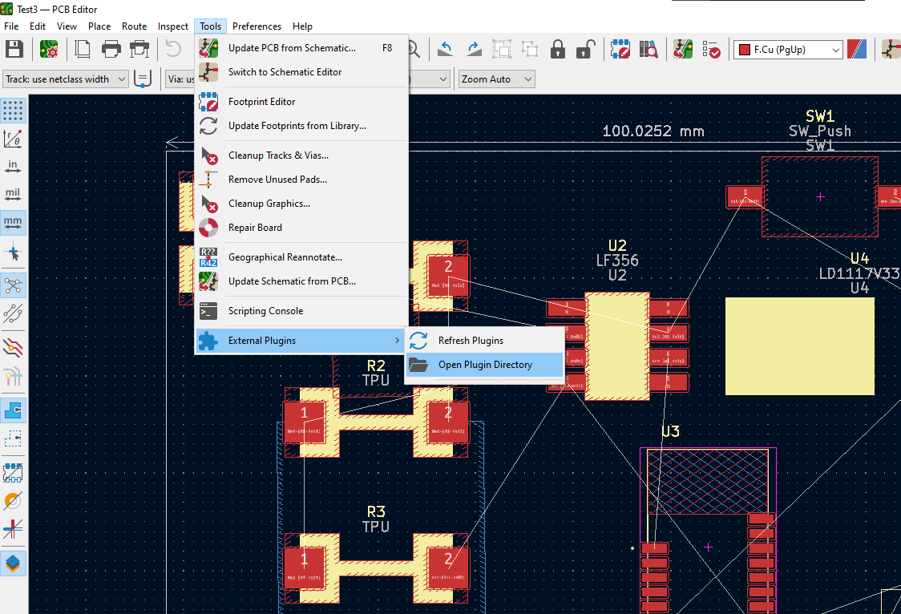
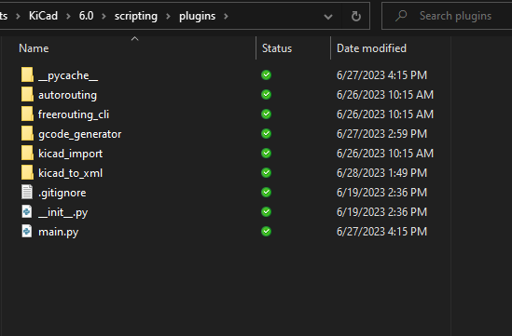
Install code in Plugins directory
Open the unrouted KiCAD file on the PCB Editor in KiCAD and navigate to Open Plugin Directory.
Copy the contents of the src folder from the repository to the “plugins” folder

Slide 4
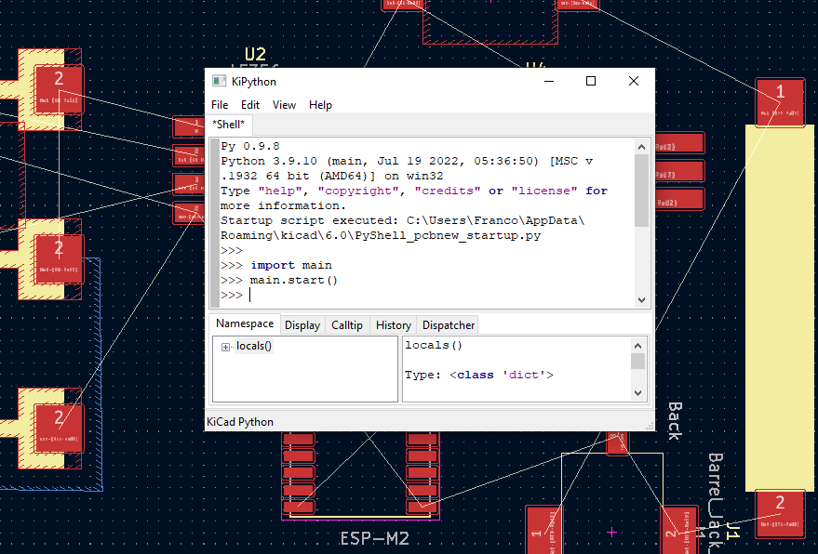
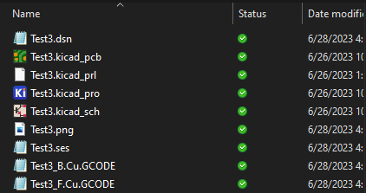
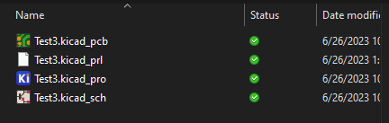
Run GCODE Generator
To autogenerate the double layer GCODE, navigate to the python scripting console (under Tools) and call the start() function from the main module.
The produced files should be on the KiCAD file’s root directory.

